Slide 1


PointSAM: Class-Agnostic Segmentation of 3D Point Clouds for Outdoor Driving Scenes
Presenter: Arya Araban
Supervisors: A/Prof Kourosh Khoshelham, Cipher Zhang
The University of Melbourne

Slide 2

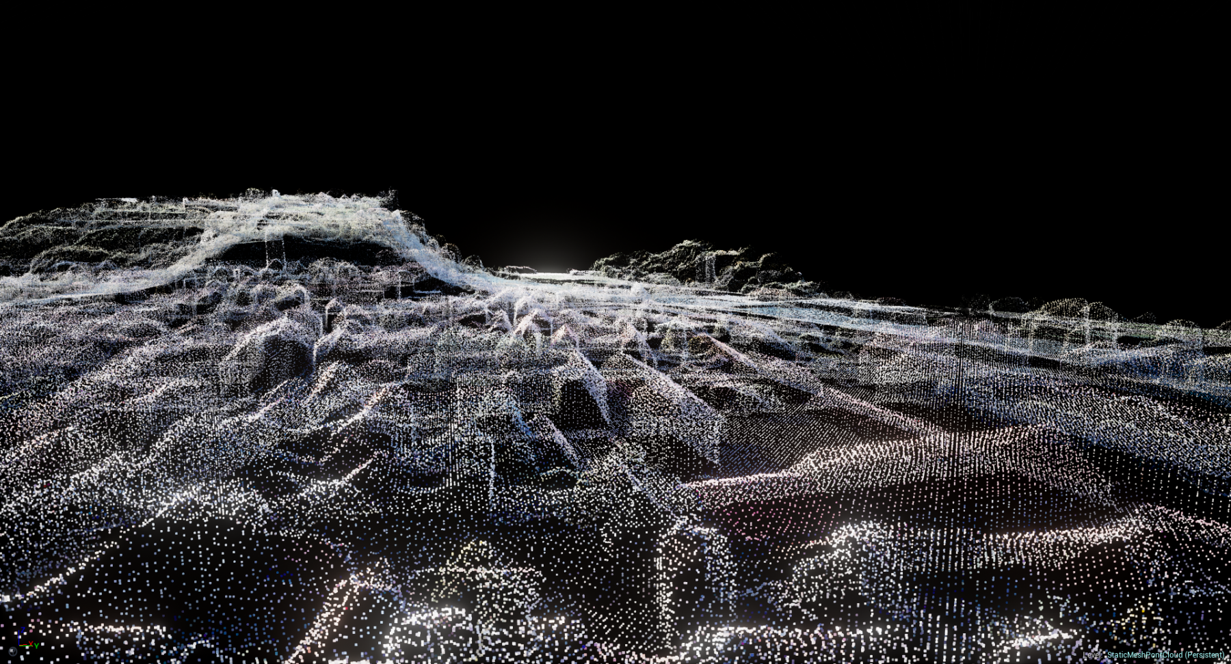
02
Background
3D point clouds are rich geometric structures of real-world environments, and are more challenging to work with than images.
Point Cloud segmentation is the task of partitioning the point cloud into distinct objects/regions. There are two main approaches to segmentation.
Semantic segmentation focuses on segmenting and classifying pre-defined categories, contrasting with class-agnostic segmentation which segments arbitrary objects without labels.

Slide 3

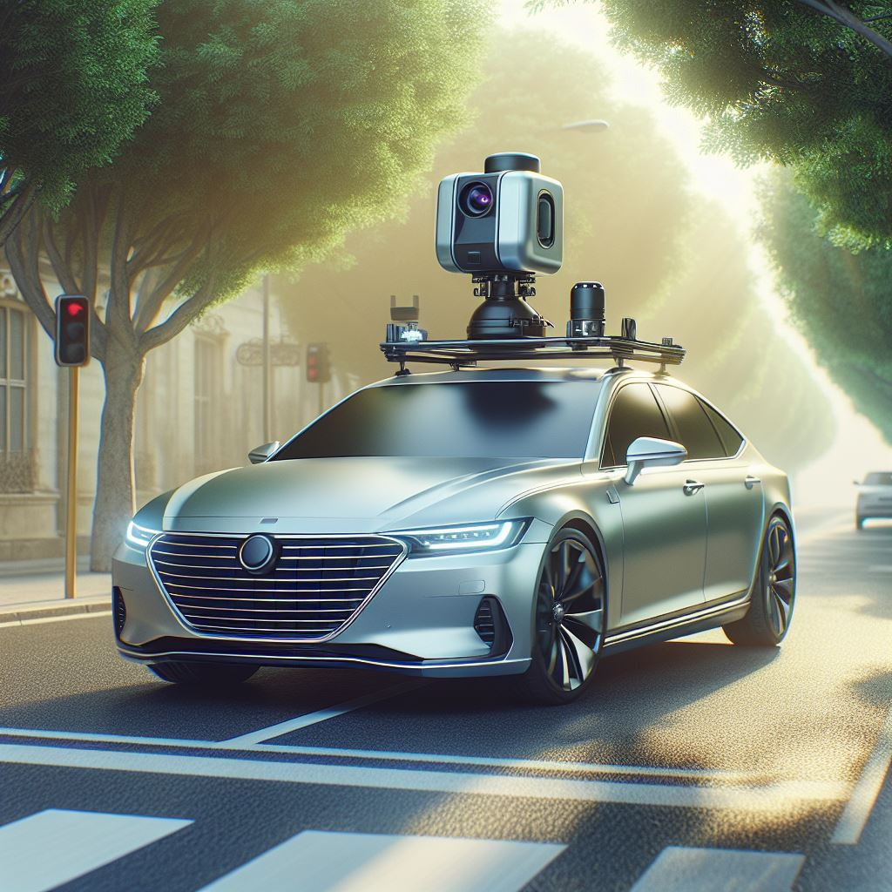
S
Problem Statement
3D Class-agnostic segmentation has several benefits including better handling of unseen domains, flexibility, efficient training of ML/DL models.
Despite the potential benefits, 3D class-agnostic segmentation remains an underexplored area compared to semantic segmentation.
This results in a critical research gap of effectively segmenting arbitrary objects in 3D point cloud data.
03

Slide 4
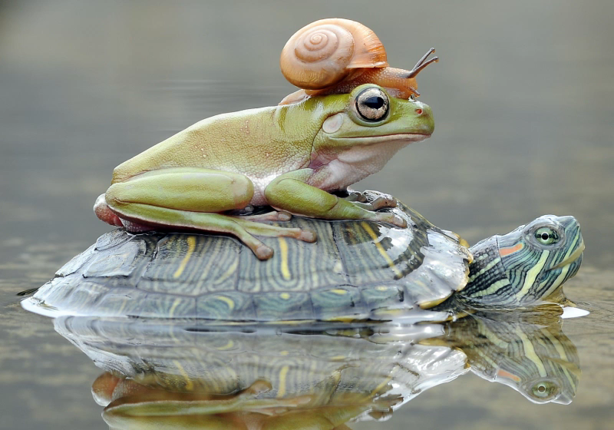

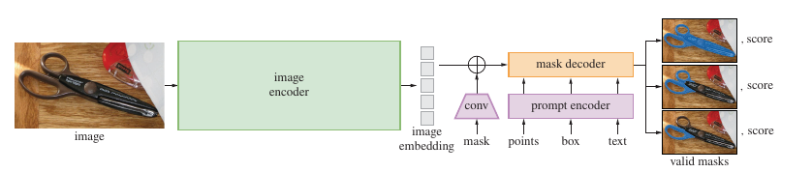
04
Segment Anything Model
The Segment Anything Model (SAM) revolutionized 2D image segmentation of arbitrary objects.
The Architecture of SAM includes three main Components: The Image encoder, the prompt encoder, and the mask decoder.

Slide 5
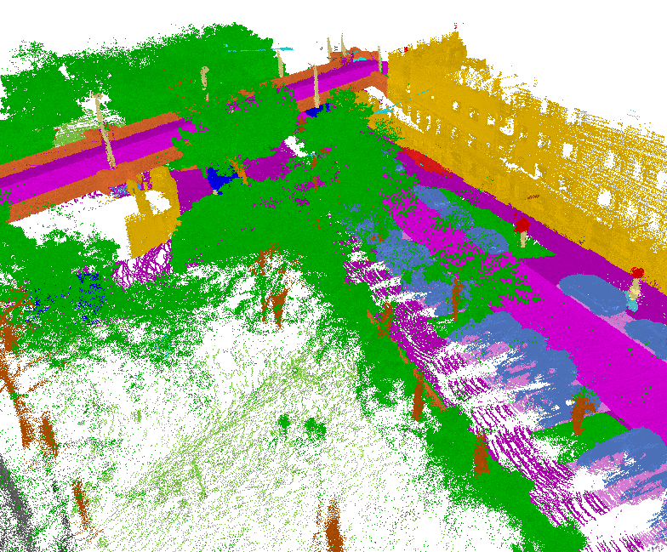
05
Research Goal
Our research aims to pioneer a novel architecture to address the lack of effective class-agnostic point cloud segmentation methods.
RQ1: Can the key components of the transformer-based architecture in SAM be successfully adapted to the 3D domain to process and segment class-agnostic 3D point cloud data?
RQ2: Can synthetic 3D data be used to pre-train a high-performing model for class-agnostic 3D point cloud segmentation in real-world scenarios, reducing the need for extensive labeled real-world data?

Slide 6




06
Methodology
Data Collection & Preprocessing
Model Development
Model Evaluation
Gather relevant data. followed by cleaning and engineering it.
Develop and train the deep learning network for peak performance.
Evaluate how well the model performs on various datasets

Slide 7

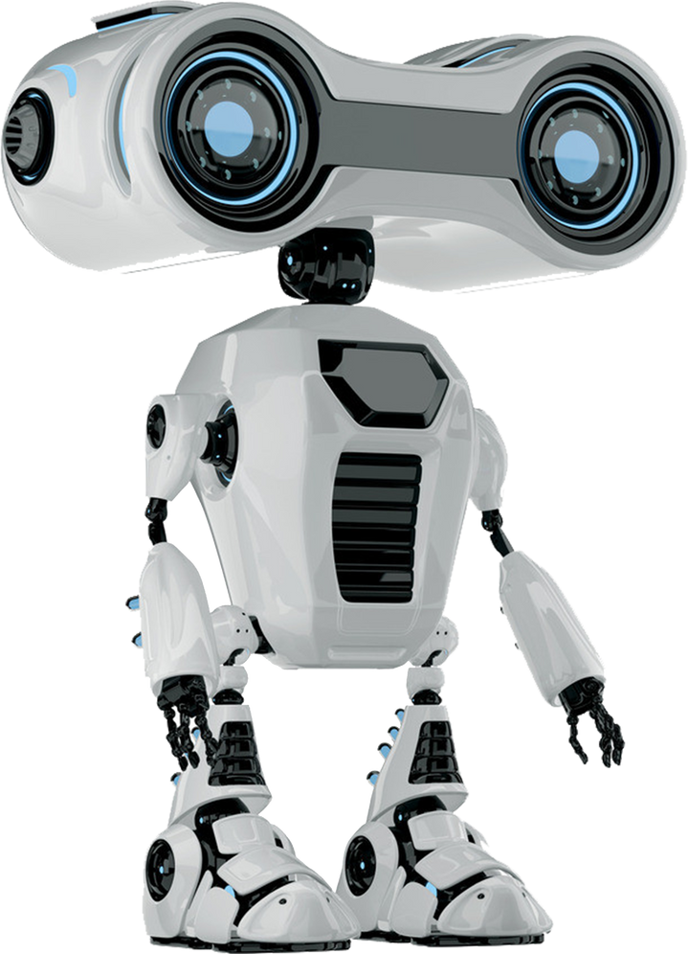
Data Collection and Preprocessing
07
We Leverage a driving scene simulation environment called CARLA for synthetic data generation
This allows capturing diverse driving scenes with varied environmental conditions, vehicle types, and object configurations
A LiDAR sensor is simulated to obtain accurate 3D point cloud representations
The preprocessing steps include:
Region of Interest (RoI) filtering, Data Augmentation

Slide 8


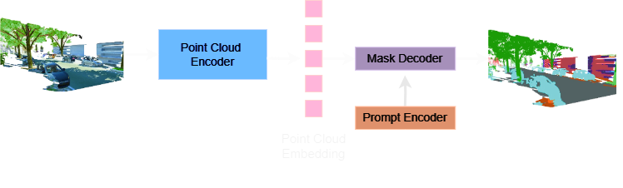
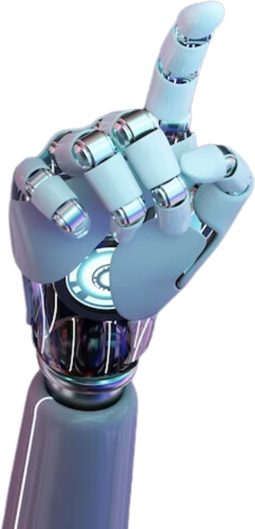
Model Architecture
Development
08
PointSAM: A transformer-based architecture for class-agnostic 3D point cloud segmentation
Three main components:
Point Cloud Encoder: Pre-trained transformer architecture (e.g., Point Transformer) to capture geometric and structural information
Prompt Encoder: 3D convolutional operations on strategically sampled point prompts from ground truth segmentation masks
Mask Decoder: integrate point cloud features and prompt embeddings by utilizing the cross-attention mechanism.

Slide 9



09
Model Evaluation
Testing procedure:
Evaluation on held-out synthetic data from CARLA
Out-of-the-box evaluation on a real-world dataset
Fine-tuning on real-world training set and evaluation on test set
Evaluation Metrics include: Mean Intersection over Union (mIoU), Precision and Recall
Qualitative evaluation: Visual inspection of predicted segmentation masks

Slide 10
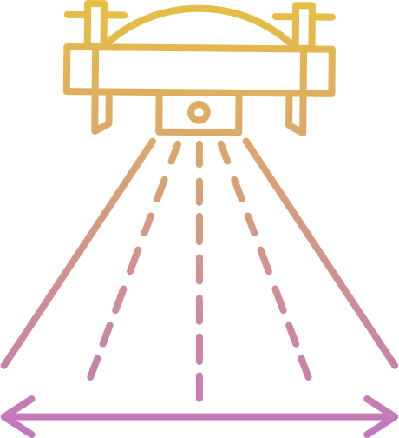
Expected Contributions
Development of a transformer-based architecture tailored for class-agnostic 3D point cloud segmentation
Effective utilization of synthetic data for pretraining and transfer learning.
Comparison with existing class-agnostic segmentation approaches, showcasing performance improvements
10

Slide 11
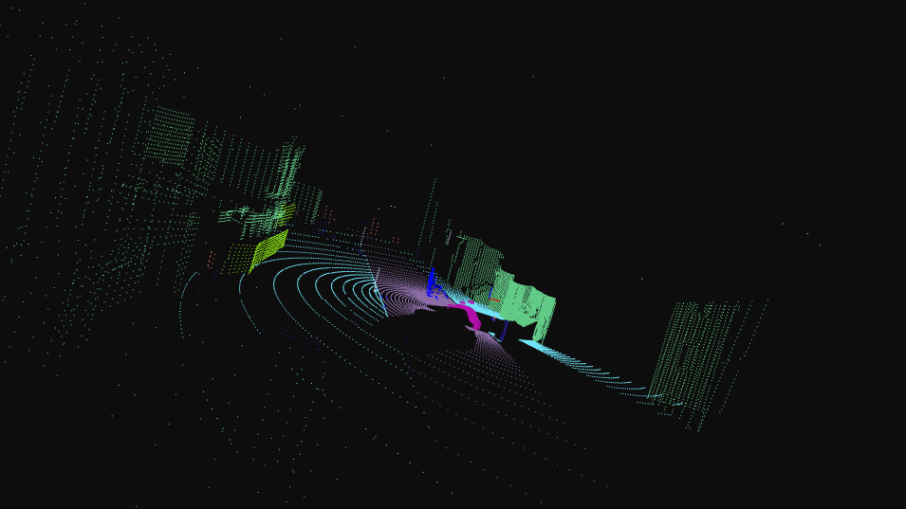
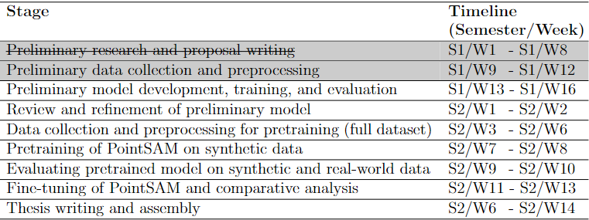
Progress Report
Set up CARLA enviornment which utilizes a simulated semantic LIDAR sensor for data capturing (car is autopilot).
Enabled 3D point cloud data capturing with tunable hyperparameters (ie, number of points, field depth)
Challenge: CARLA does not provide instance level segmentation. We aim to solve this with DBSCAN
11

Slide 12




Thank You For Your Attention!
Any Questions?
arya-araban
aaraban@student.unimelb.edu.au

